Slide 1


AAHLS Final Presentation
Dec 29, 2022
The Hardware Acceleration of
Monocular Visual Odometry
Presenter: 張惇宥 朱怡蓁 許家維
Advisor: Prof. 賴瑾
Graduate Institute of Electronics Engineering, National Taiwan University

Slide 2
Outline
Introduction
Monocular Visual Odometry Algorithm
Profiling
Algorithm and HLS Optimization
System Architecture
Performance Evaluation
Reference

Slide 3
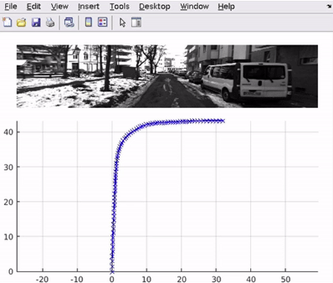
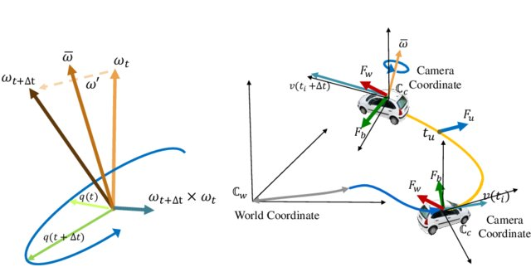
Introduction
Convert image sequences to camera position
Used in a wide variety of robotic applications

Slide 4
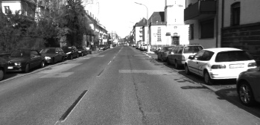
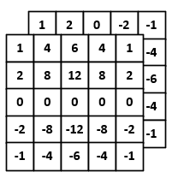
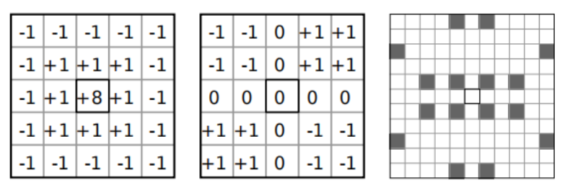
Monocular Visual Odometry
Input image sequence.
Use Blob, Corner, and Sobel filters to detect features in the images.
Non-maximum
Suppression
2
2
Features
Local min/max

Slide 5
Monocular Visual Odometry
Feature matching
The motion of feature point is limited
Using local search rather than global search

Slide 6
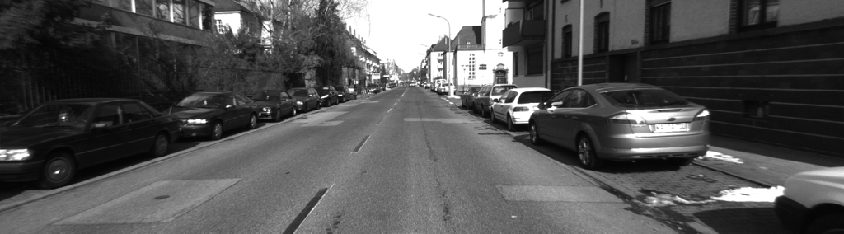
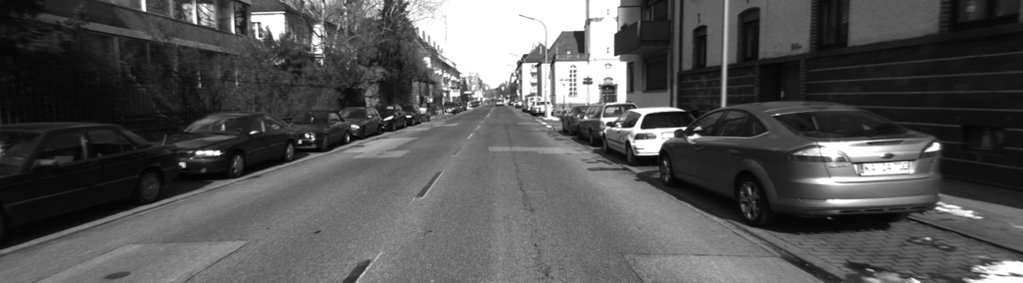
Monocular Visual Odometry
Feature matching
Using the Circular Match method.
Matched
NOT Matched

Slide 7
Monocular Visual Odometry
Remove Outlier
Remove outlier by Delaunay Triangulation
Bucketing Strategy
Split the whole image domain into buckets of the same size.
Limit the number of features in each bucket.
Use the 8-point algorithm with RANSAC to compute the essential matrix.
Estimate R and t using the essential matrix obtained in the previous step.

Slide 8
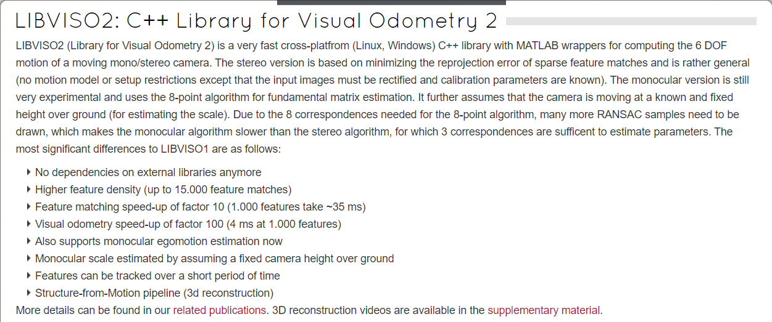
Open Source: Libviso2
Open source code: https://www.cvlibs.net/software/libviso/ [1]
Dataset: https://www.cvlibs.net/datasets/karlsruhe_sequences/ [2]

Slide 9
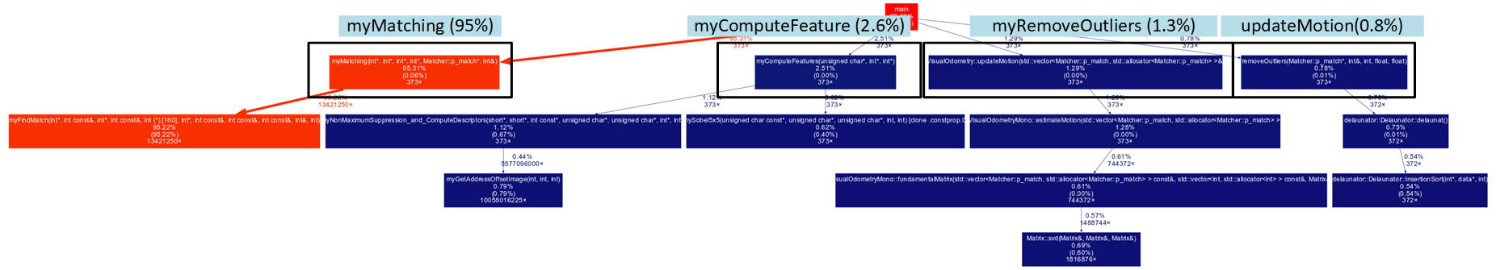
Profiling
Using “gprof” to explore function hierarchy and runtime of each function
 | myMatching | myComputeFeature | updateMotion | removeOutlier
Time Ratio | 95.31% | 2.51% | 0.76% | 1.29%

Slide 10
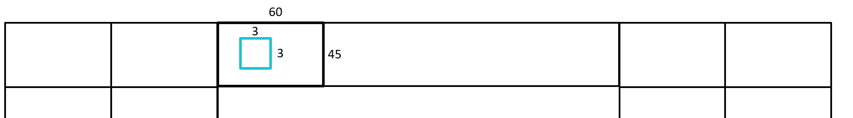
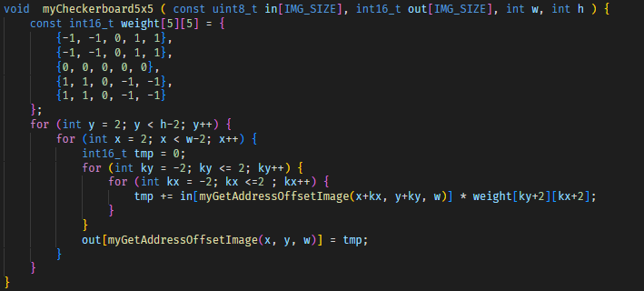
Compute Feature
Arranging data into bucket in compute feature kernel rather than matching kernel
Reduce the latency of matching kernel
We plan to use DATAFLOW to design compute feature
However, it is not the bottleneck stage and we encounter some memory issue
We use the original C++ code to synthesis

Slide 11
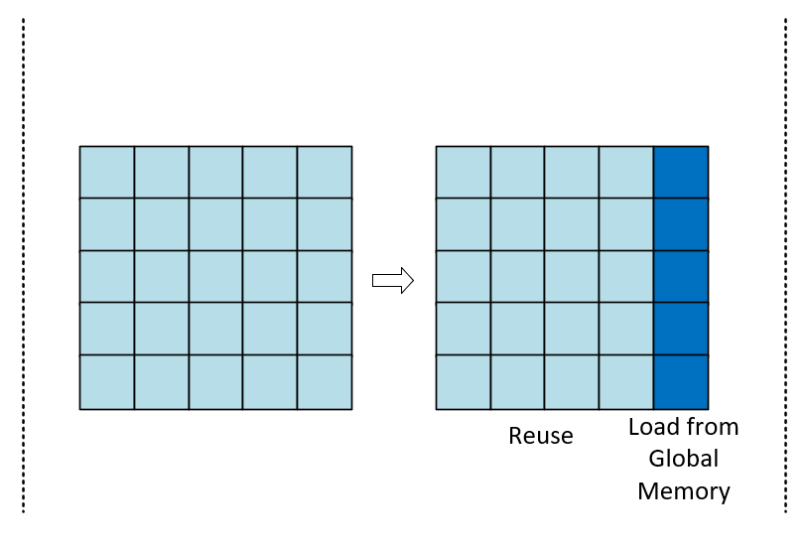
Compute Feature – Future Work
The memory access is not efficient in current design (no burst access)
There is also no parallelism in current design
However, if the matching kernel become faster, compute feature will become bottleneck
We plan to use window buffer only to balance the performance and memory usage
Current
Window Buffer
Window Buffer +
Line Buffer
No data reuse
Fully reuse

Slide 12
Matching
Data-level parallelism in find match
Pipeline II=1
Parallelism on computing distance of two 32-dim vectors
Data buffer and fetch strategies
1/3 on chip memory reuse compare to fully buffered
Each data only need one global memory access
Reduce BRAM usage
Using #pragma bind_storage to use Ultra RAM

Slide 13
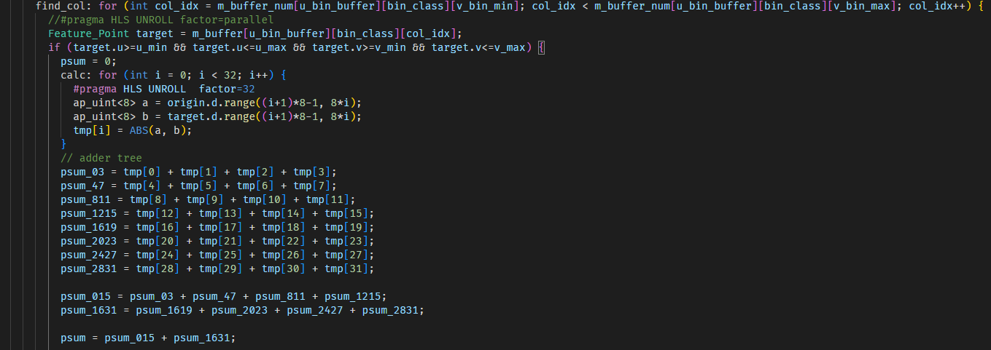
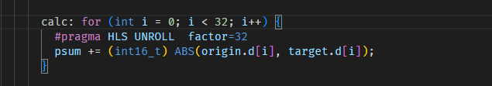
Data-Level Parallelism in Find Match
Hand-craft adder tree to guide HLS tool
“find_col” loop has II=1
Improved
Original

Slide 14
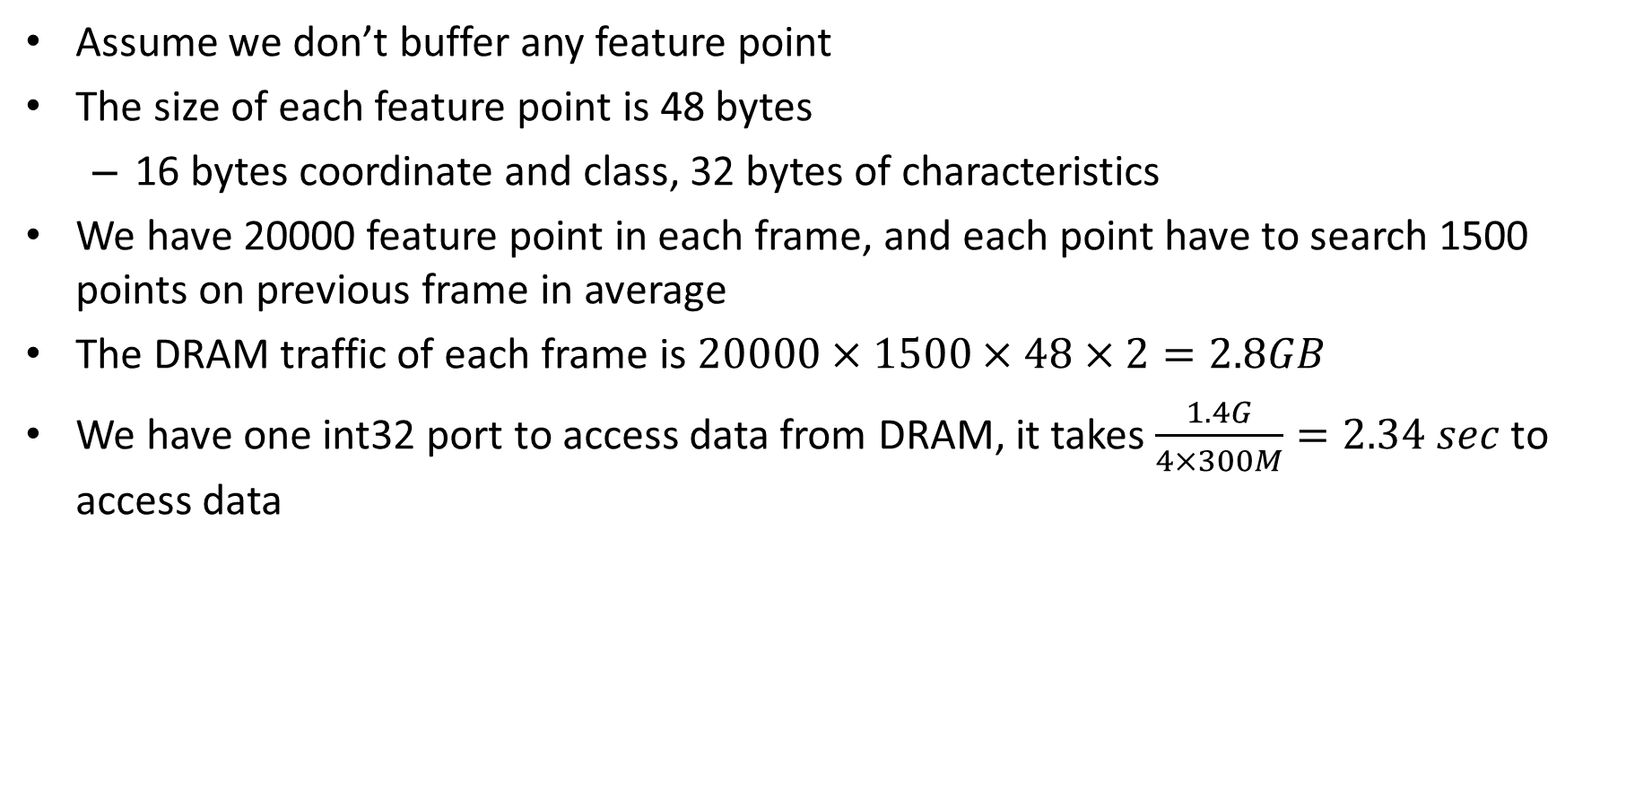
DRAM Traffic
Assume we don’t buffer any feature point
The size of each feature point is 48 bytes
16 bytes coordinate and class, 32 bytes of characteristics
We have 20000 feature point in each frame, and each point have to search 1500 points on previous frame in average
The DRAM traffic of each frame is $20000×1500×48×2=2.8GB$
We have one int32 port to access data from DRAM, it takes $\frac{1.4G}{4×300M}=2.34 sec$ to access data

Slide 15
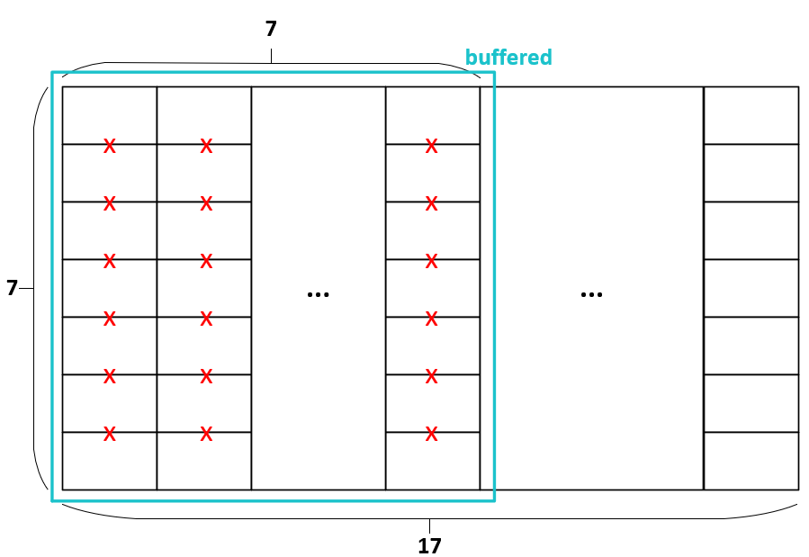
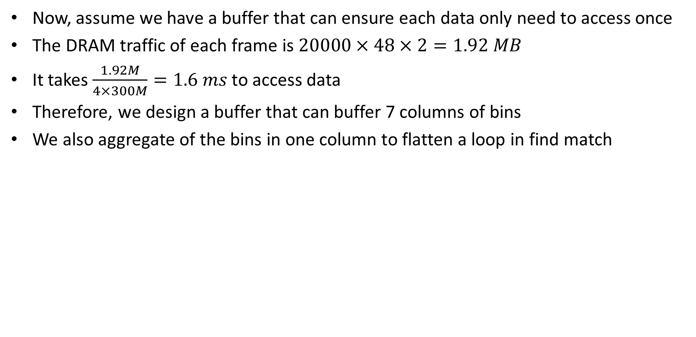
Data Buffer
Now, assume we have a buffer that can ensure each data only need to access once
The DRAM traffic of each frame is $20000×48×2=1.92 MB$
It takes $\frac{1.92M}{4×300M}=1.6 ms$ to access data
Therefore, we design a buffer that can buffer 7 columns of bins
We also aggregate of the bins in one column to flatten a loop in find match

Slide 16
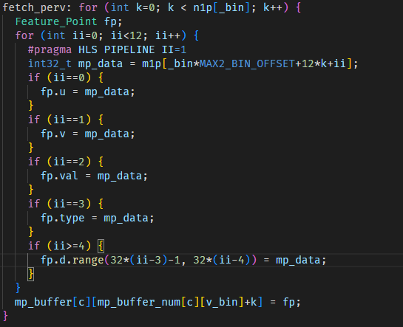
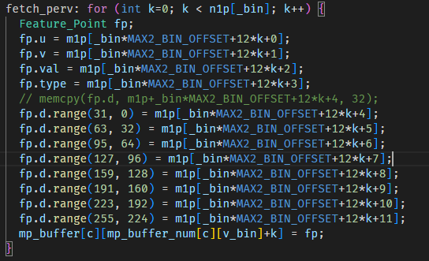
Fetching Strategies
Using for loop with #pragma PIPELINE II=1 explicitly to enable burst transfer
original
improved

Slide 17
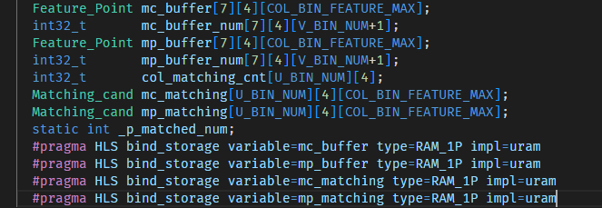
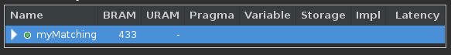
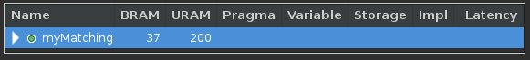
Reducing BRAM Usage
Using Ultra RAM
Original (433)
Improved (37)

Slide 18
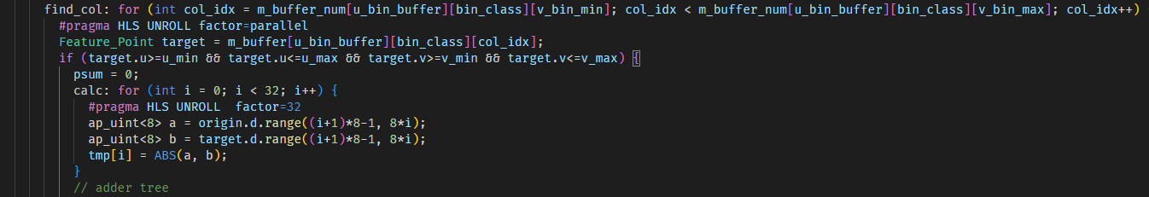
Matching – Future work (1/2)
Data-level parallelism in find match
Unroll the find match loop to increase the number of parallelism
Set ARRAY_RESHAPE on m_buffer

Slide 19
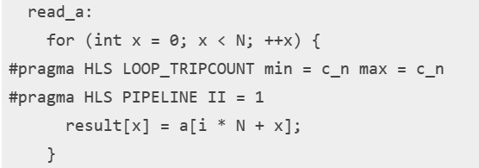
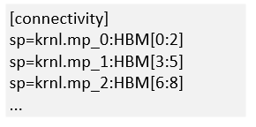
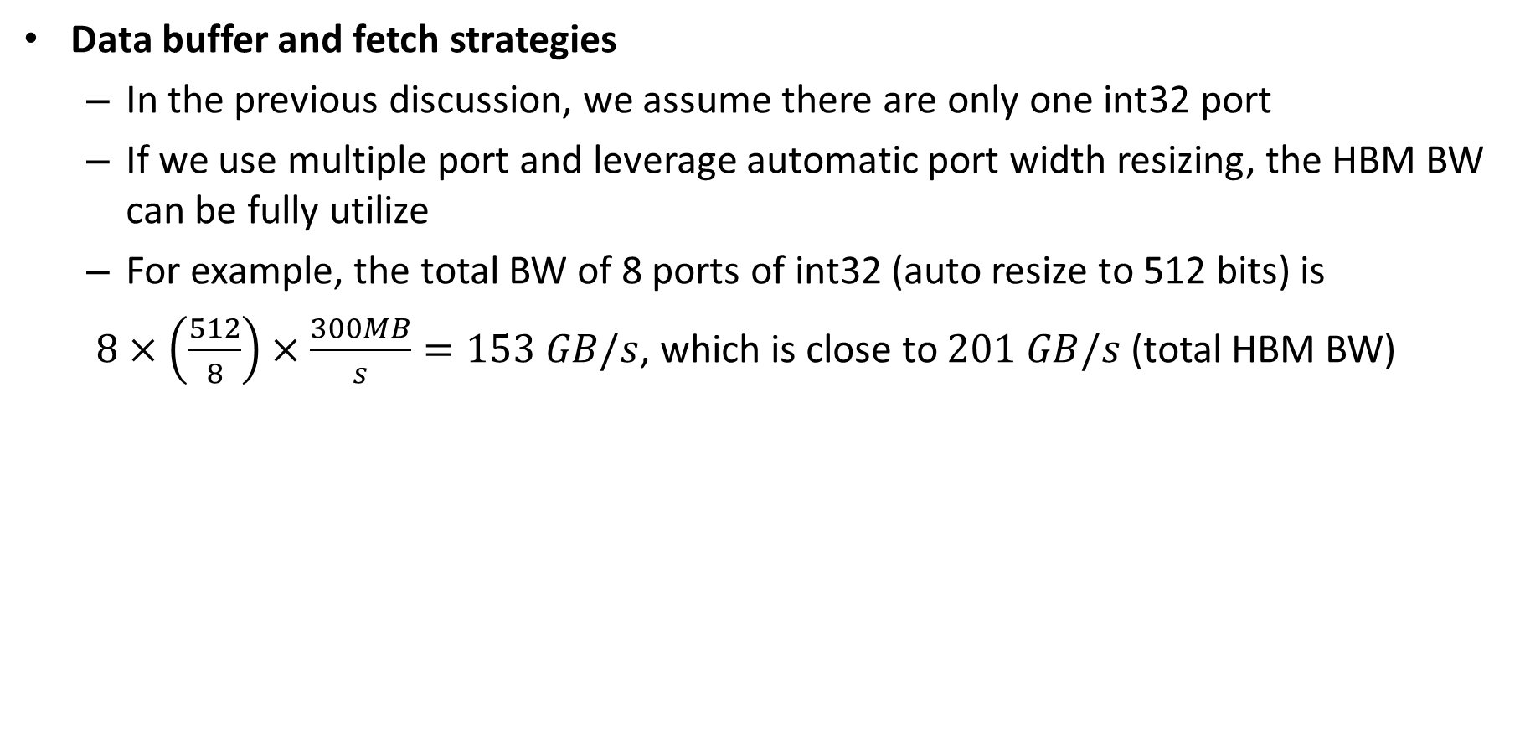
Matching – Future work (2/2)
Data buffer and fetch strategies
In the previous discussion, we assume there are only one int32 port
If we use multiple port and leverage automatic port width resizing, the HBM BW can be fully utilize
For example, the total BW of 8 ports of int32 (auto resize to 512 bits) is
$8×\left(\frac{512}{8}\right)×\frac{300MB}{s}=153 GB/s$, which is close to $201 GB/s$ (total HBM BW)
N need to be multiple of 512/32=16
Connect 3 pseudo channels to each port
https://docs.xilinx.com/r/en-US/ug1399-vitis-hls/Automatic-Port-Width-Resizing

Slide 20
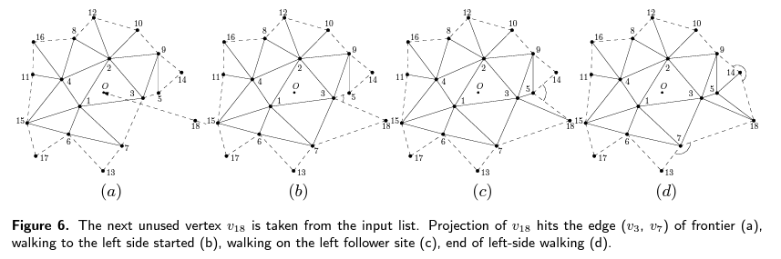
Remove Outliers
Delaunay Triangulation
Sweep Circle Algorithm [3]
Complexity: O(NlogN)
Remove outliers
Calculate support for each edge to eliminate outliers

Slide 21
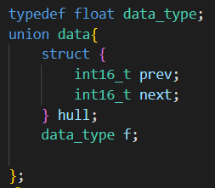
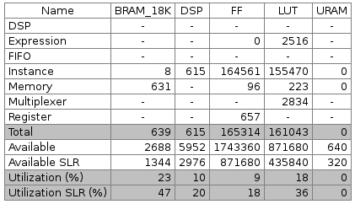
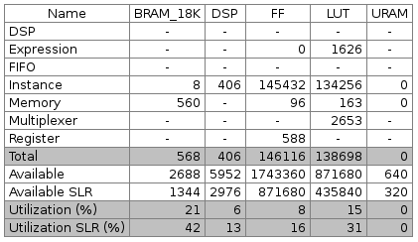
Storage Optimization for Remove Outliers
Target: reduce memory usage
Change double to float
Reuse array by using union: float = 2 x int16_t
Memory usage: 631 -> 560 BRAM_18K
Notes:
Remove outliers not bottleneck -> reduce memory

Slide 22
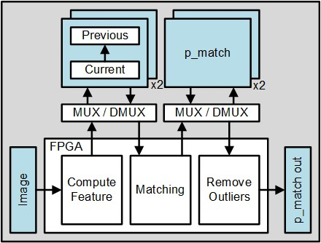
Architecture
Task level parallelism
Use double buffer in global memory
Cl::Buffer DB[2]
for i = 0…numImg-1 do
flag ← i%2
if i >=2 then
wait until finish migrating i-2th result to host
endif
DB[flag] ← create buffer by using host pointer
set kernel arguments
add events into queue with dependencies
endfor
https://github.com/Xilinx/Vitis_Accel_Examples/blob/master/host/overlap/src/host.cpp

Slide 23
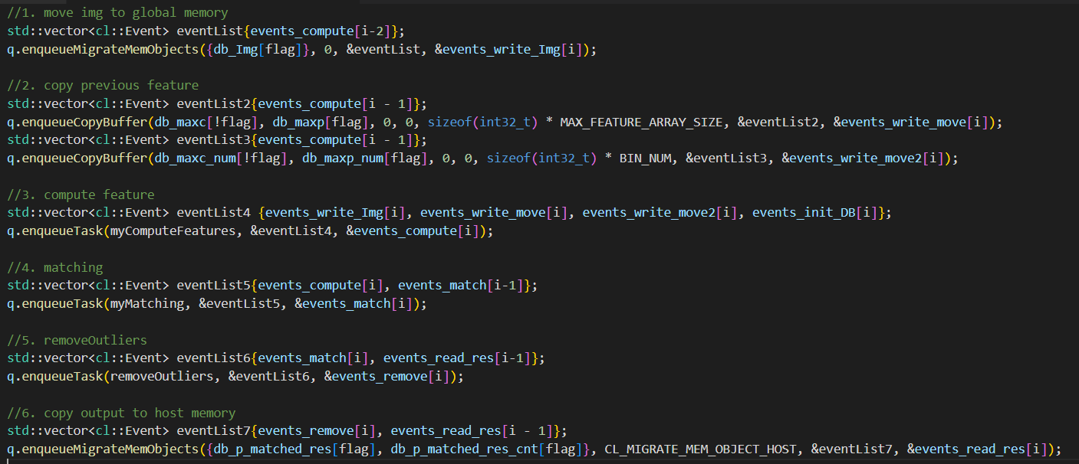
List of Events

Slide 24
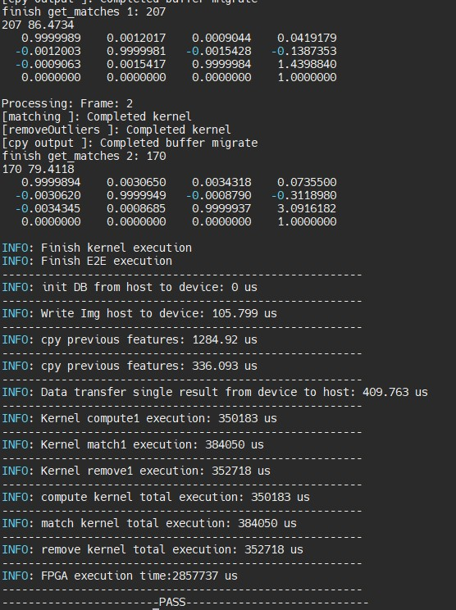
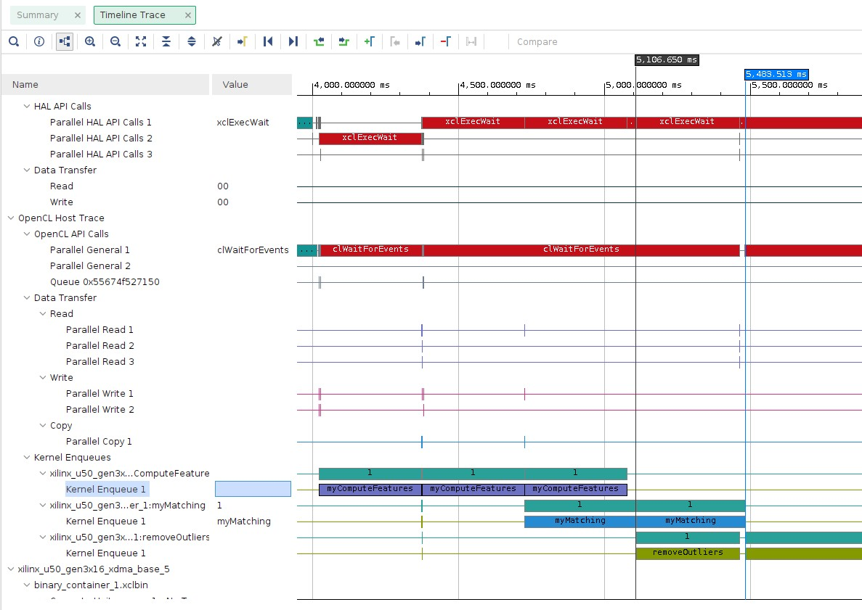
Performance Evaluation
i7 CPU: 0.59 frame/second
This work: 2.5 frame/second

Slide 25
Reference
[1] Repo: https://www.cvlibs.net/software/libviso/
[2] Dataset: https://www.cvlibs.net/datasets/karlsruhe_sequences/
[3] Ahmad Biniaz et al., “A faster circle-sweep Delaunay triangulation algorithm,” Advances in Engineering Software, Pages 1-13, Volume 43, Issue 1, 2012.

